Slide 1



Predicting Bitcoin Prices
by Afif Salman

Slide 2

Introduction
1
Objective
The objective is to predict Bitcoin prices to assist traders and investors in making informed decisions.
2
Importance
Bitcoin's high volatility presents both opportunities and risks for investors, making accurate predictions valuable.

Slide 3

Time Series Visualization
1
Time Series Visualization
Historical Bitcoin price data was analyzed to understand trends and patterns over time.
2
Insights
This visualization helps illustrate how Bitcoin prices have fluctuated historically, providing insights into market behavior.

Slide 4
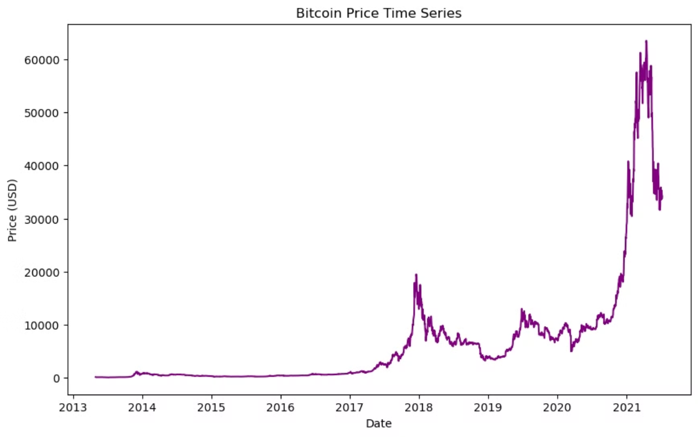
Graph

Slide 5

Distribution Plot
Distribution of Bitcoin Prices
Insights
A histogram was created to show the distribution of Bitcoin prices.
This plot helps understand the frequency and range of Bitcoin price movements, essential for predicting future price trends.

Slide 6
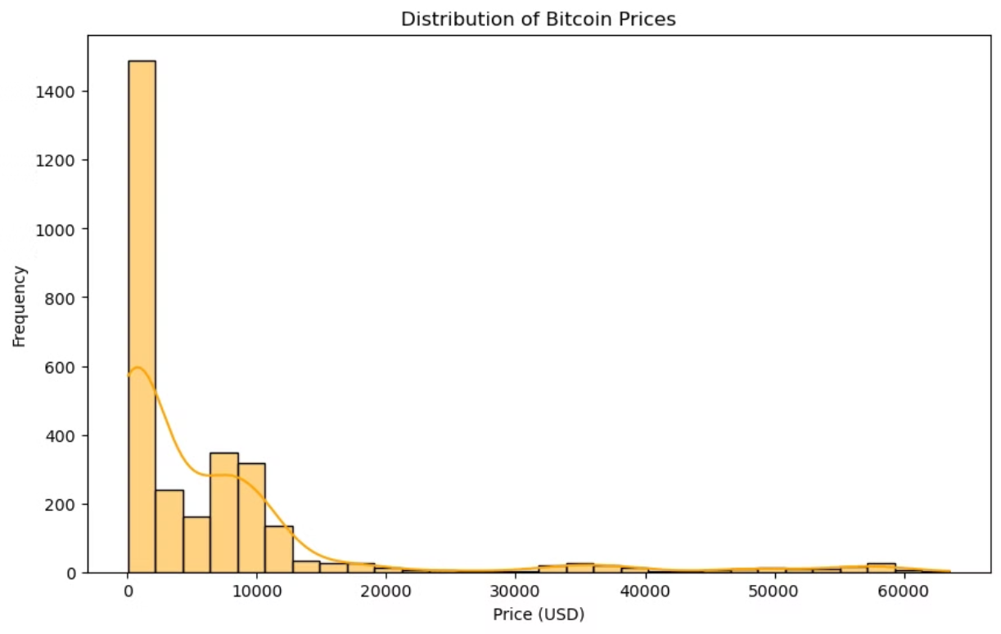

Graph

Slide 7
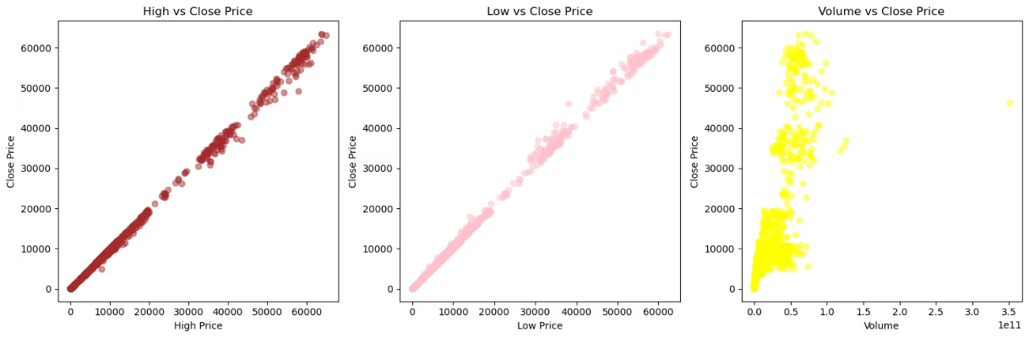
Feature Analysis
Feature Analysis
Insights
Features such as 'High vs Close Price', 'Low vs Close Price', and 'Volume vs Close Price' were analyzed using scatter plots.
These graphs illustrate correlations between different factors and Bitcoin prices, helping to identify influential variables for prediction.

Slide 8



Feature Engineering
Feature Engineering
New features like lagged prices and extracted date components (day, month, year) were engineered.
Benefits
These enhancements improved the model's ability to capture significant trends in Bitcoin price movements.

Slide 9

Data Preparation
Data Splitting
The data was split into training and testing sets, allocating 80% for training and 20% for testing.
Standardization
Numerical features were standardized using the StandardScaler to ensure all variables contribute equally to the model.

Slide 10




Model Training and Evaluation
Model Selection
Model Training
Model Evaluation
Linear Regression was selected as the model for predicting Bitcoin prices due to its simplicity and effectiveness with continuous data.
The Linear Regression model was trained using the scaled training data.
The model's performance was evaluated using metrics such as Mean Squared Error (MSE) and R-squared (R²).
Mean Squared Error (MSE): 48,080.04
Measures the average squared difference between predicted and actual prices. Lower values indicate better accuracy.
R-squared (R²): 0.9996
Indicates how well the model's predictions explain the variation in Bitcoin prices. A value closer to 1 signifies a strong fit.

Slide 11
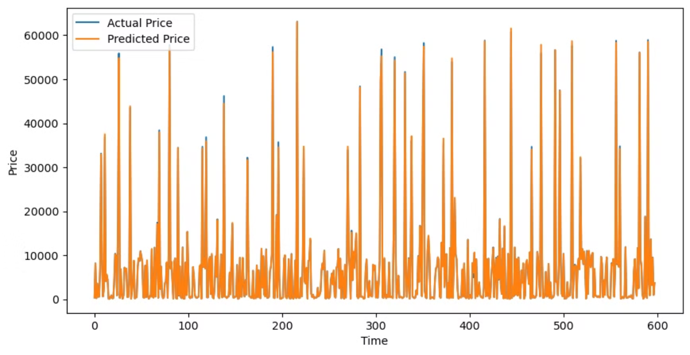
Result

Slide 12

Conclusion
In conclusion, the model successfully predicts Bitcoin prices based on historical data and identified market trends. This approach can help traders and investors make more informed decisions in the volatile cryptocurrency market.

Slide 13
References
Nakamoto, S. (2008). Bitcoin: A peer-to-peer electronic cash system. Retrieved from https://bitcoin.org/bitcoin.pdf
Yermack, D. (2015). Is Bitcoin a real currency? An economic appraisal. Handbook of Digital Currency, 31-43. https://doi.org/10.1016/B978-0-12-802117-0.00002-5
Kristoufek, L. (2015). What are the main drivers of the Bitcoin price? Evidence from wavelet coherence analysis. PLOS ONE, 10(4), e0123923. https://doi.org/10.1371/journal.pone.0123923
Urquhart, A. (2016). The inefficiency of Bitcoin. Economics Letters, 148, 80-82. https://doi.org/10.1016/j.econlet.2016.09.019
Cheah, E.-T., & Fry, J. (2015). Speculative bubbles in Bitcoin markets? An empirical investigation into the fundamental value of Bitcoin. Economics Letters, 130, 32-36. https://doi.org/10.1016/j.econlet.2015.02.029

Slide 14

Q&A
Thank you for your attention! I welcome any questions or comments you may have. Let's open the floor for discussion.

